Slide 1
Dimethyl ether (DME) Production
Zezheng Li, Matr. Nr. 416038
Elvis Sim, Matr. Nr. 418012
Ilias Chair, Matr. Nr. 406149
August 2023
Computer-Aided Process Design, Chair of Process Systems Engineering

Slide 2
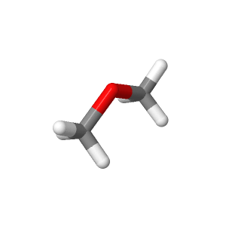








Background about DME production
Motivation
A precursor to other commodity chemicals
An aerosol propellant
Alternative or additive to diesel
Raw materials and process design
Concerns
Problem
Solutions
Natural gas, carbon dioxide and steam
Syngas
MeOH
DME
Production

Slide 3
Framework and key chemical reactions
Natural gas, CO₂ and steam
Steam methane reforming
Syngas
Steam methane reforming
MeOH
Steam methane reforming
DME
Chemical reactions:
CH₄ + H₂O
3H₂ + CO
3H₂ + CO₂
CH₃OH + H₂O
CO + H₂O
H₂ + CO₂
H₂ + CO₂
CO + H₂O
2CH₃OH
2CH₃OCH₃ + H₂O
CH₄ + 2H₂O
4H₂ + CO₂
H₂ + CO
CH₃OH
Reaction kinetic model: Langmuir-Hinshelwood-Hougen-Watson (LHHW) kinetic

Slide 4
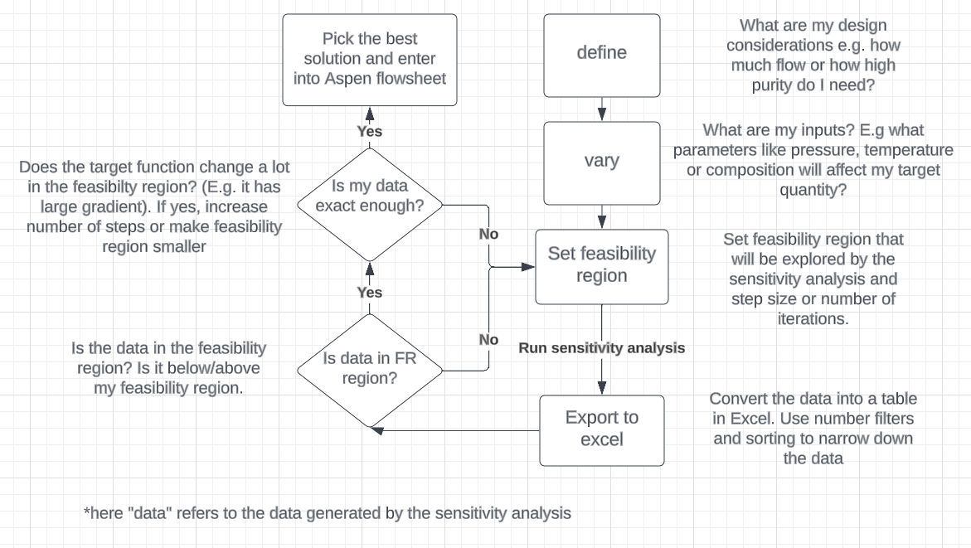
Optimization in Aspen Plus
Numerical Optimization: Iteratively adjusting variables to minimize or maximize an objective function(s), using mathematical algorithms and techniques.
Sensitivity Analysis: Objective function(s) are evaluated on a fixed set of values, to assess the impact of variations in input parameters on the output. SA output can be analyzed and evaluated to optimize a process.

Slide 5
Syngas production via steam reforming

Slide 6
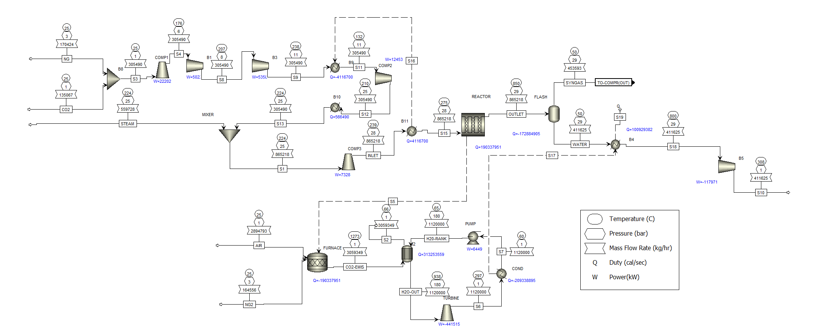
Flowsheet of syngas

Slide 7
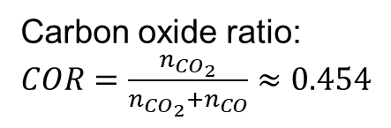
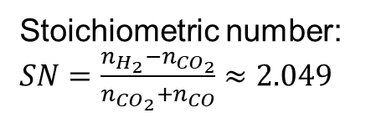
Output of the syngas production
Mole fractions:
H₂ | 0.6708
CO | 0.1464
CO₂ | 0.1216
CH₄ | 0.0540
N₂ | 0.0031
H₂O | 0.0041
Stoichiometric number: $SN=\frac{n_{H_{2}}−n_{{CO}_{2}}}{n_{{CO}_{2}}+n_{CO}}≈2.049$
Temperature | 50℃
Pressure | 29 bar
Mass flow rates | 12000 tons/day
Carbon oxide ratio: $COR=\frac{n_{{CO}_{2}}}{n_{{CO}_{2}}+n_{CO}}≈0.454$

Slide 8
Methanol synthesis

Slide 9
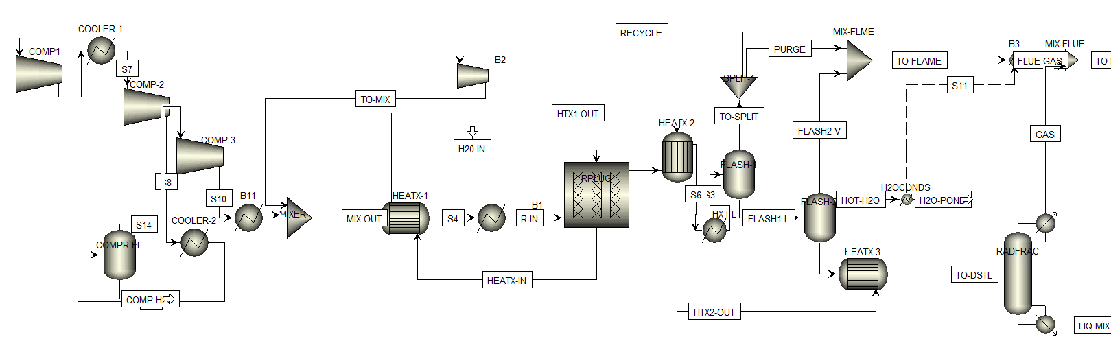
Methanol Synthesis from Synthesis Gas

Slide 10
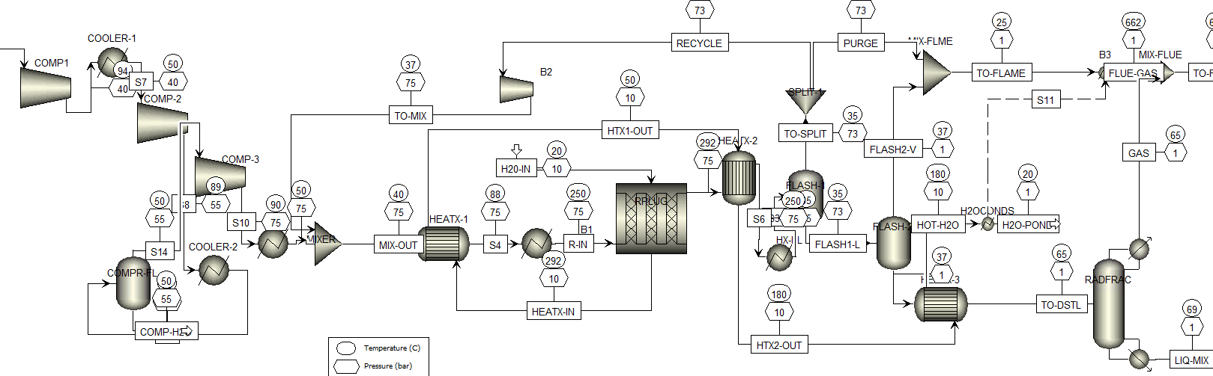

Slide 11
Feed to Dimethyl-Ether Synthesis Plant
Components | Mass Fraction
H2 | 1.5327E-20
CO | 9.3132E-19
CO2 | 7.2247E-08
CH4 | 2.0699E-15
N2 | 1.8682E-20
H2O | 0.1949
CH3OH (Methanol) | 0.8050
O2 | 0
DME (Dimethyl-Ether) | 0

Slide 12
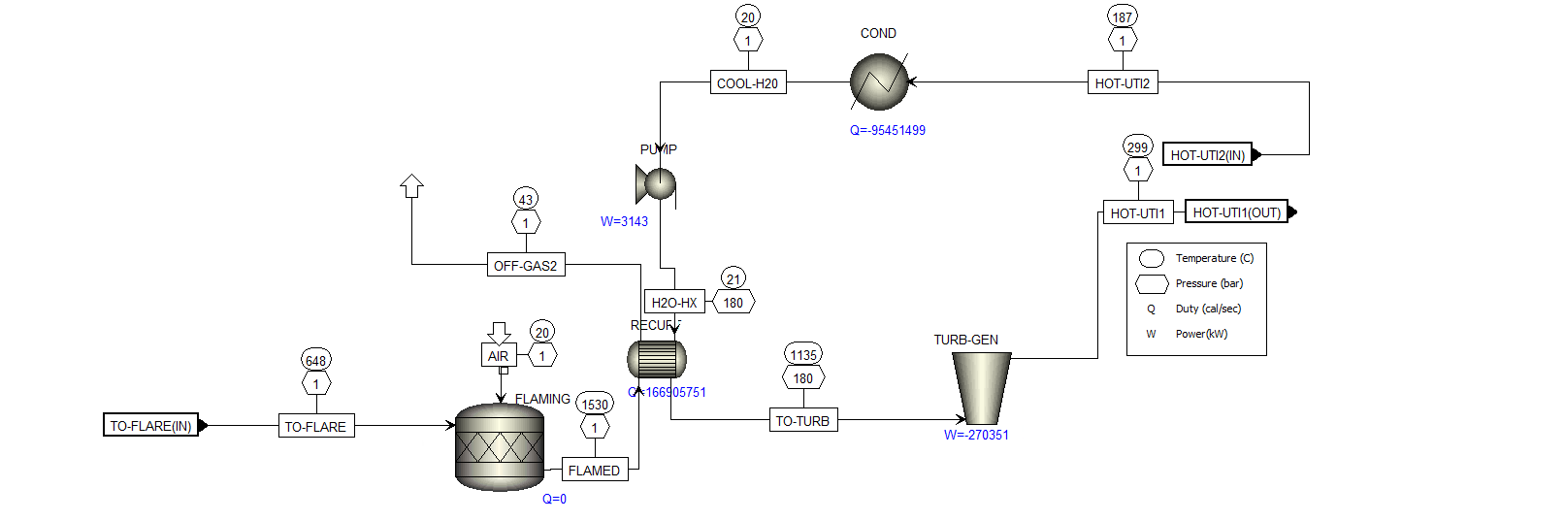
Integrated Rankine Cycle

Slide 13
DME synthesis

Slide 14
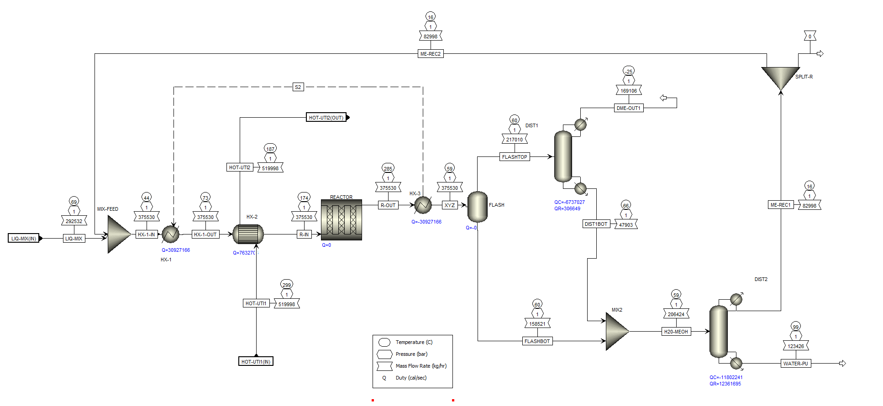
DME Plant overview

Slide 15
DME Plant summary
197°C, 1 bar
water steam
DME-Plant
99.995% DME
80.5% Methanol
19.5% Water
99.79% H2O
0.2% Methanol
297°C, 1 bar water steam
Column QR^{[1]}: Nat. Gas
Column QC^{[2]}: Cooling water, cryogenically
Design targets:
Produce very high purity DME
Toxicity of purge streams must be low
Achieve high conversion
Keep utility and material costs low
^{[1]} QC = Distillation column condenser duty
^{[2]} QR = Distillation column reboiler duty

Slide 16
Economic analysis and results

Slide 17
Economic analysis (capital costs and utility costs)
The capital expenditure amounts to 114,399,847.8 euros. The total utility cost per year is 85,316,384.3 euros.
Name | Value | Unit
Total heating duty | 89,810,024.4 | cal/sec
Total cooling duty | 324,488,355 | cal/sec
Net duty | -234,678,330 | cal/sec
Total heating cost flow | 8,460.37372 | USD/hr
Total cooling cost flow | 2,361.08544 | USD/hr
Net cost | 10,821.4592 | USD/hr
Net cost flow of feeds | 185,247,815.8 | USD/year
Net cost flow of products | 653,621,342.6 | USD/year
Overall net cost flow | 468,373,526.7 | USD/year

Slide 18
Economic analysis (profitability and revenue from electricity sale)
The process yields an annual revenue of approximately 636,808,419 euros.
After deducting the yearly raw material cost of 503,774,022 euros and utility expenses, the resulting net profit stands at around 47,718,012.7 euros.
Given an estimated plant lifespan of 20 years, the investment ratio evaluates to 0.1836.
The pay out time is 4.795 years.
The process requires a total of 106.68 MW of electricity, while generating a substantial 829.84 MW in return. This results in a surplus of 723.16 MW of electricity.
Selling at 90% of the market rate generates approximately 285,068,651 euros in annual revenue.
The pay out time is 0.688 years.

Slide 19
Conclusion

